Slide 1
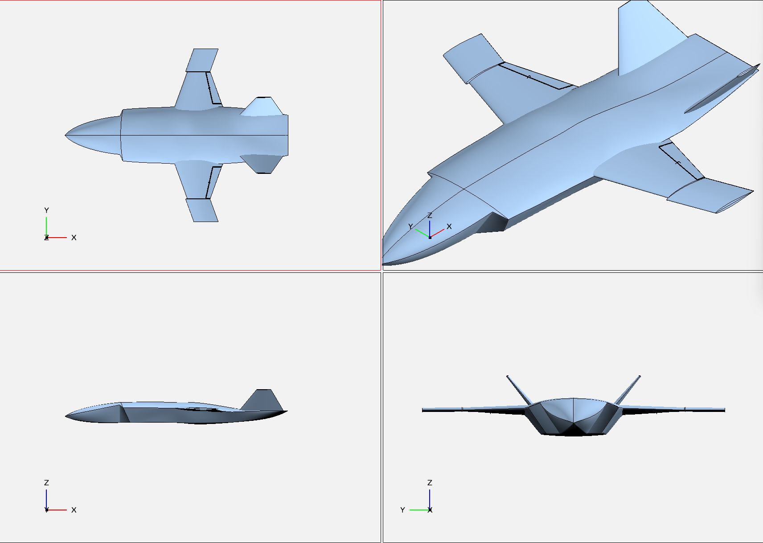
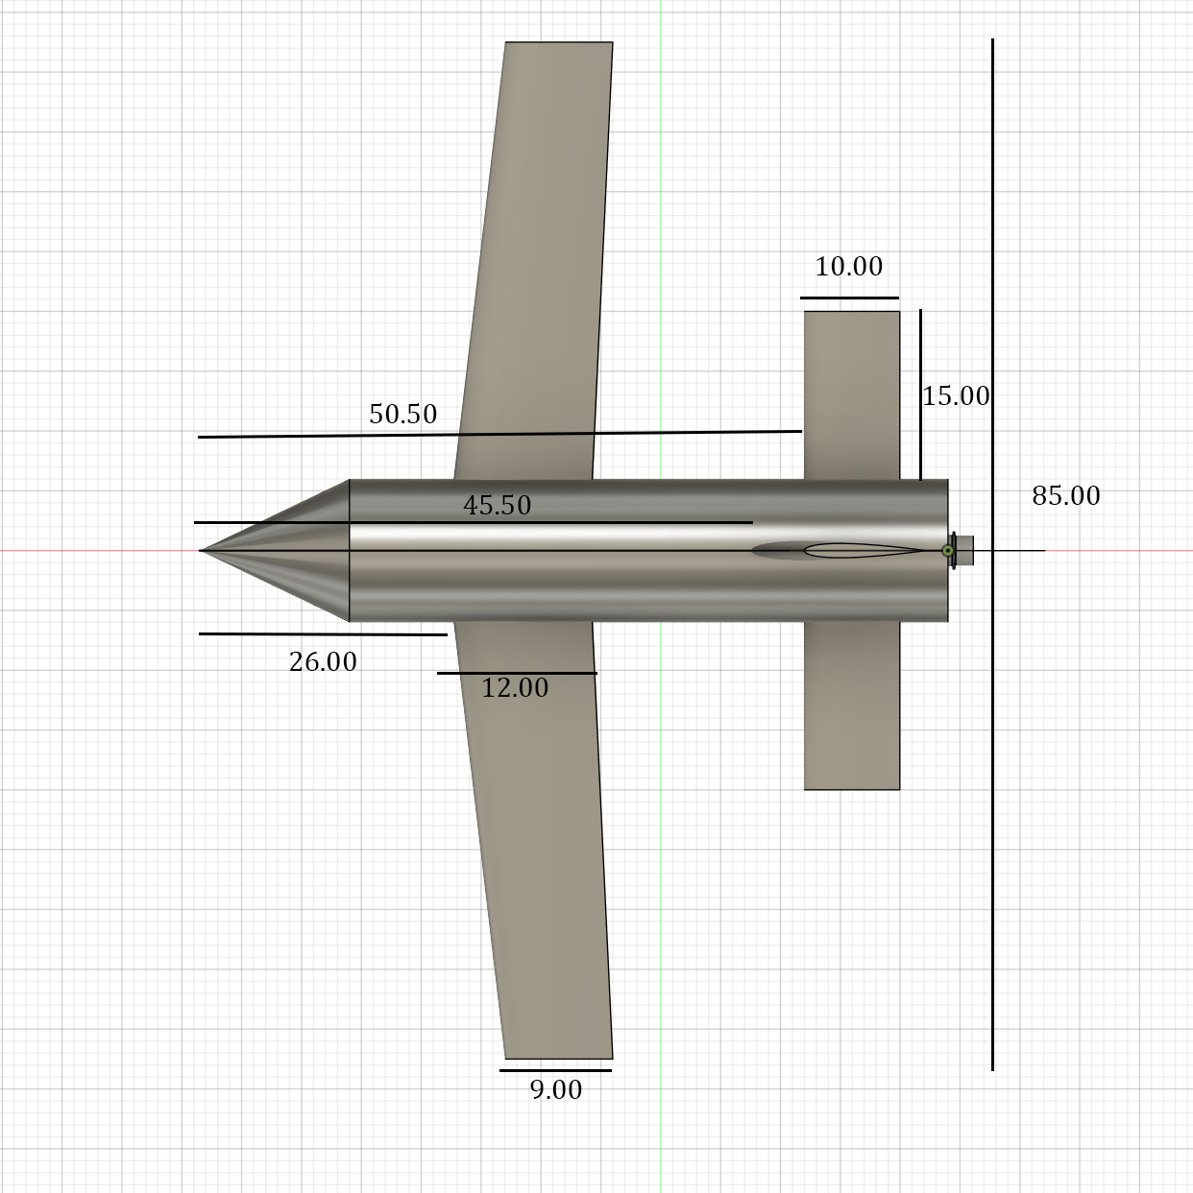
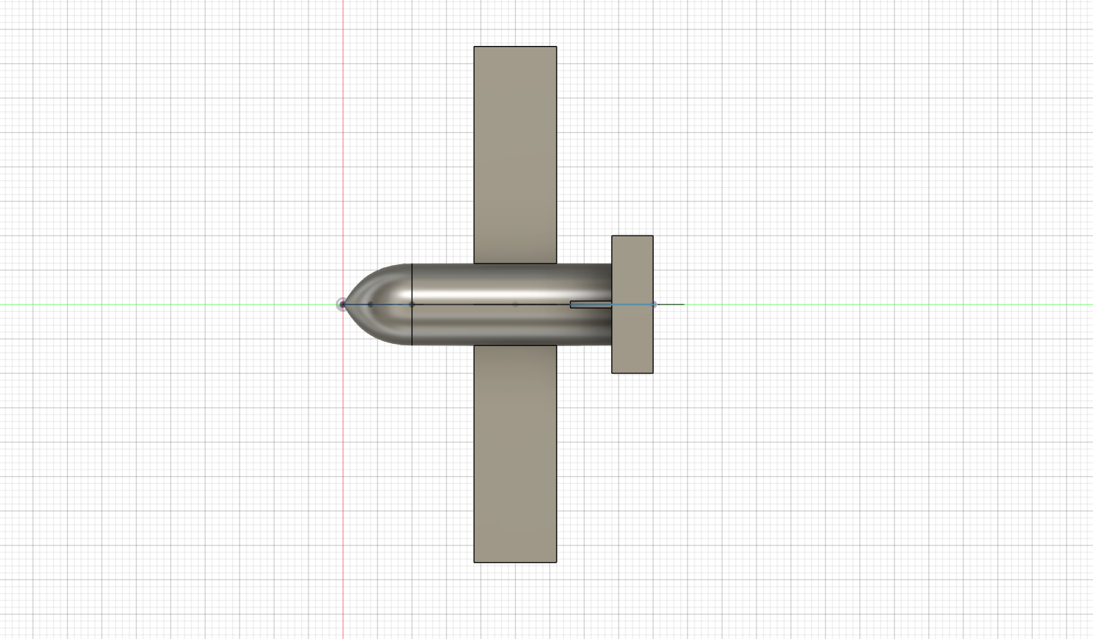
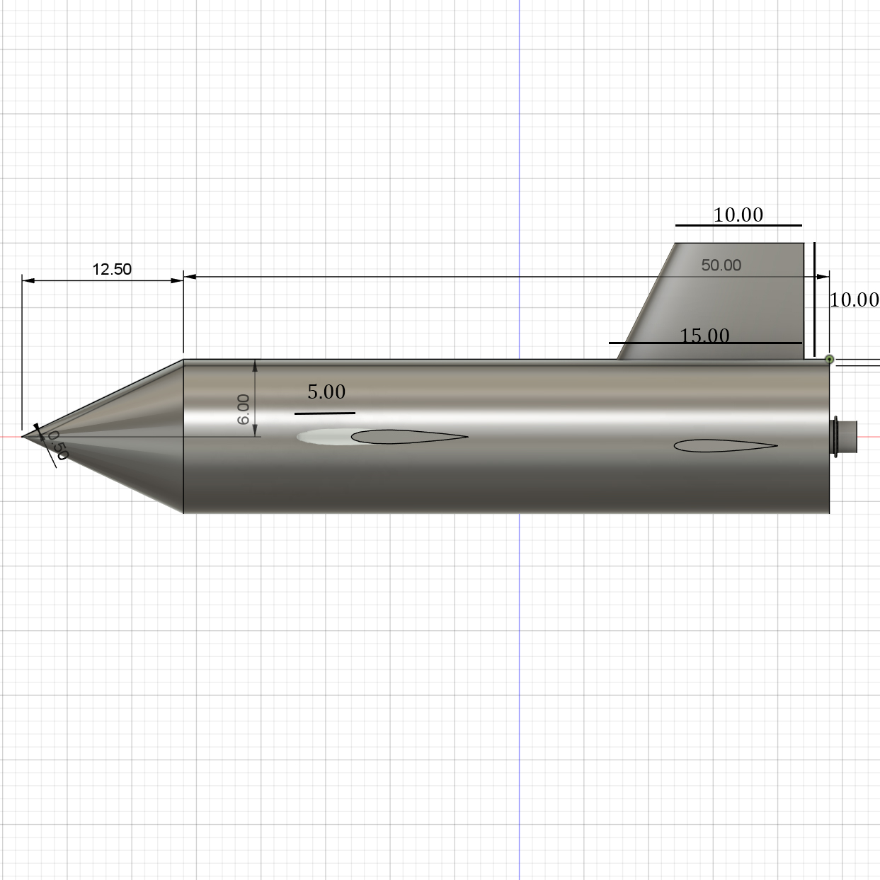
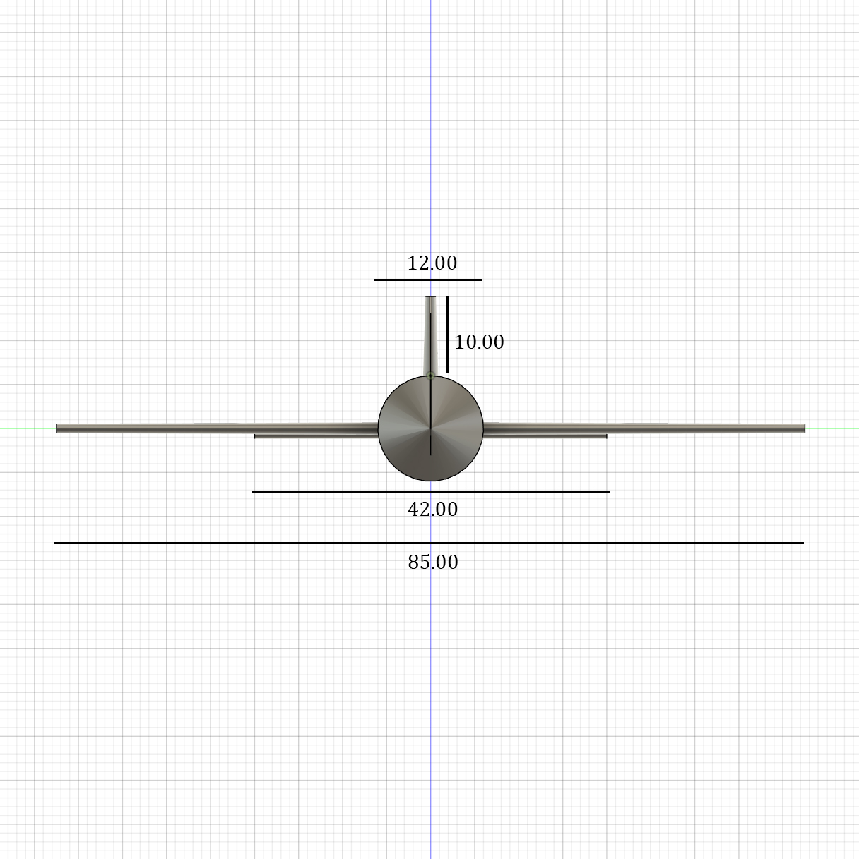
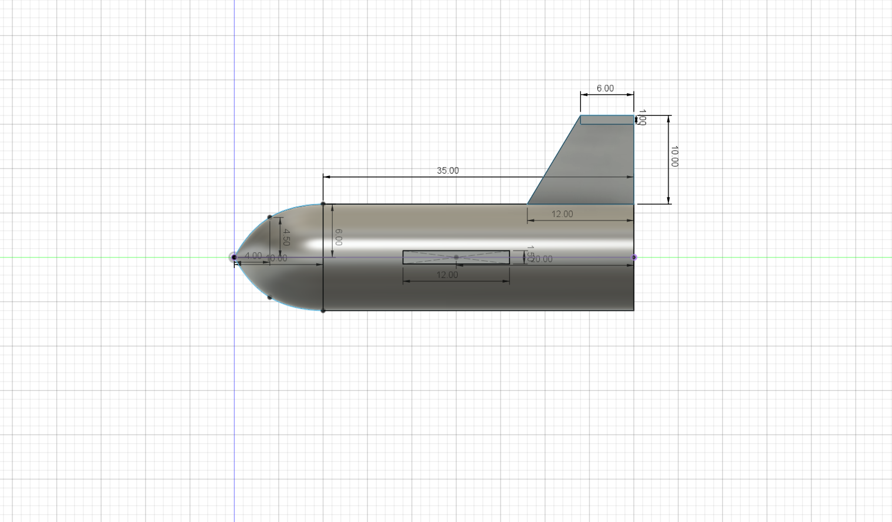
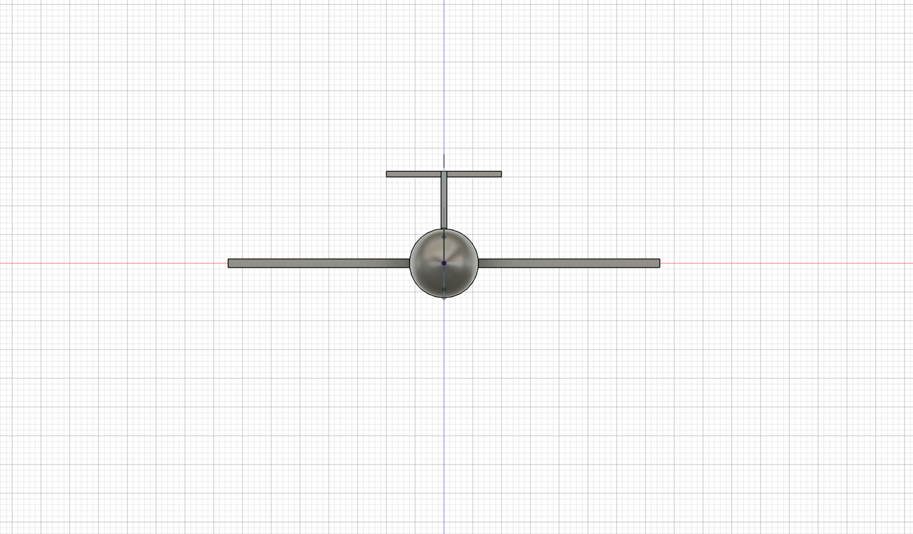
Design Configuration #1: AIRCRAFT NAME – Student Name
Dimensioned Top View
Key Configuration Parameters
Estimated Weight (N) | 7.94
Wing Planform Area – S_{ref} (m^2) | 0.089
Wing Loading – W/S (N/m^2) | 23.02
Wing Aspect Ratio – AR | 8.1
Wing Taper Ratio | 0.75
Wing Leading Edge Sweep (deg) | 6.7
Wing Airfoil | NACA 0012
Fuselage Fineness Ratio | 5.21
Drag Polar Model Equation | Simplified
L/D max Estimate | 10.15
Design Approach
Simple Conventional Aircraft Design
Conventional design to attempt to work with MATLAB model (high predictability and reliability)
Long wings (increase span to increase lift)
A thick fuselage is needed to hold a 2L Coke bottle inside.
Configuration Strengths
Well modeled by the MATLAB code
Stable with low tail incidence angle
Has a longer range
Easy to adjust configuration
Configuration Weaknesses
May tend to spiral
On the heavier side
Does not glide that well
Other Key Configuration Considerations
Fabrication: 3D Printed Wing Segments
Cost: Low Cost
Schedule: It could take a while to fabricate components and adjusting on the fly might be hard.
Other:
Dimensioned Side View
Dimensioned Front View

Slide 2
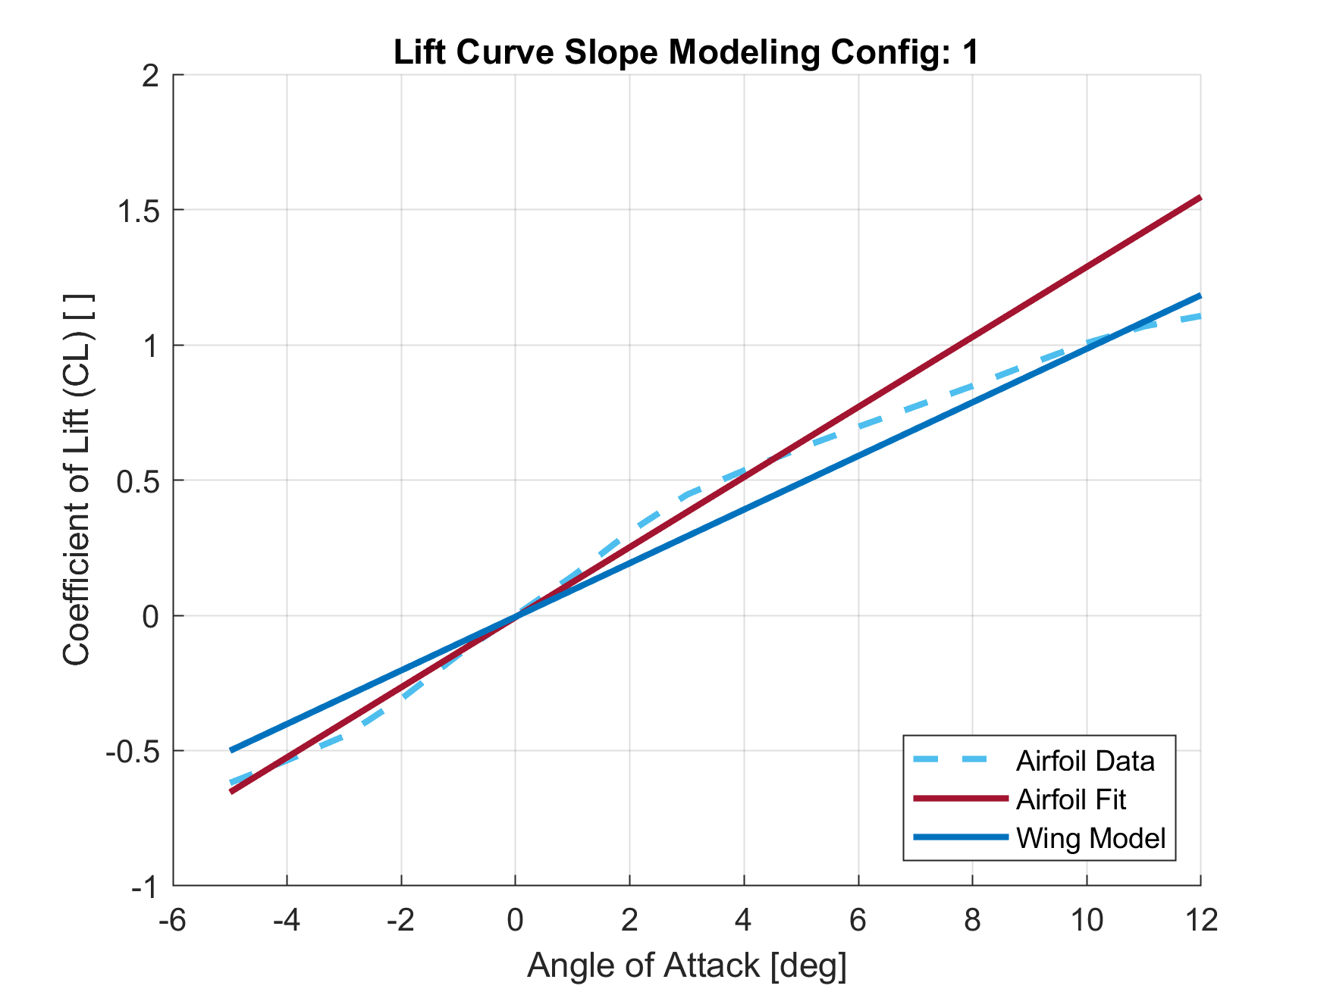
Lift Curve Model
Insert your Lift Curve Plot (CL vs Angle of Attack) here:
Include on the same plot
  2-D airfoil lift curve
  3-D wing lift curve model
Make sure plot is formatted adequately
  Axis Titles + Units (if applicable)
  Proper range used for both vertical and horizontal axes
  Legend
Airfoil and Wing Parameters | Value
Airfoil Type | NACA 0012
Wing AR | 8.095
Wing Taper Ratio | 0.75
Wing Sweep (at quarter chord) | 6.7
Wing Model Span Efficiency (e) | 0.9503
 | Lift Curve Slope (1/deg) | Zero Lift Angle of Attack (α_{L=0} in deg) | Stall Angle of Attack (α_{stall} in deg)
2-D Airfoil | 0.13 /deg | 0.05 deg | 12 deg
3-D Wing | 0.1 /deg | 0.05 deg

Slide 3
Parasite Drag Model
Flow Properties
STD ATMOS Altitude | 1500 m
Mach | 0.035
Reynolds Number (Wing) | 200000
Aircraft Geometry | Form Factor (FF) | Interference Factor (Q) | Wetted Area (Swet) | Reference Dimension
Fuselage | 1.3337 | 1 | 0.1885 | Fineness Ratio (l/d) = 5.21
Wing | 1.1786 | 1.1 | 0.182 | S_{ref} = 0.089 m^2
Horizontal Tail | 1.24 | 1.05 | 0.065
Vertical Tail | 1.012 | 1.05 | 0.0256
Additional Drag | A_{base} | D/q | % L&P Assumed
Base Drag (misc) | 0.00339 m^2 | XX
Leakage & Perturbance |  |  | 3%

Slide 4
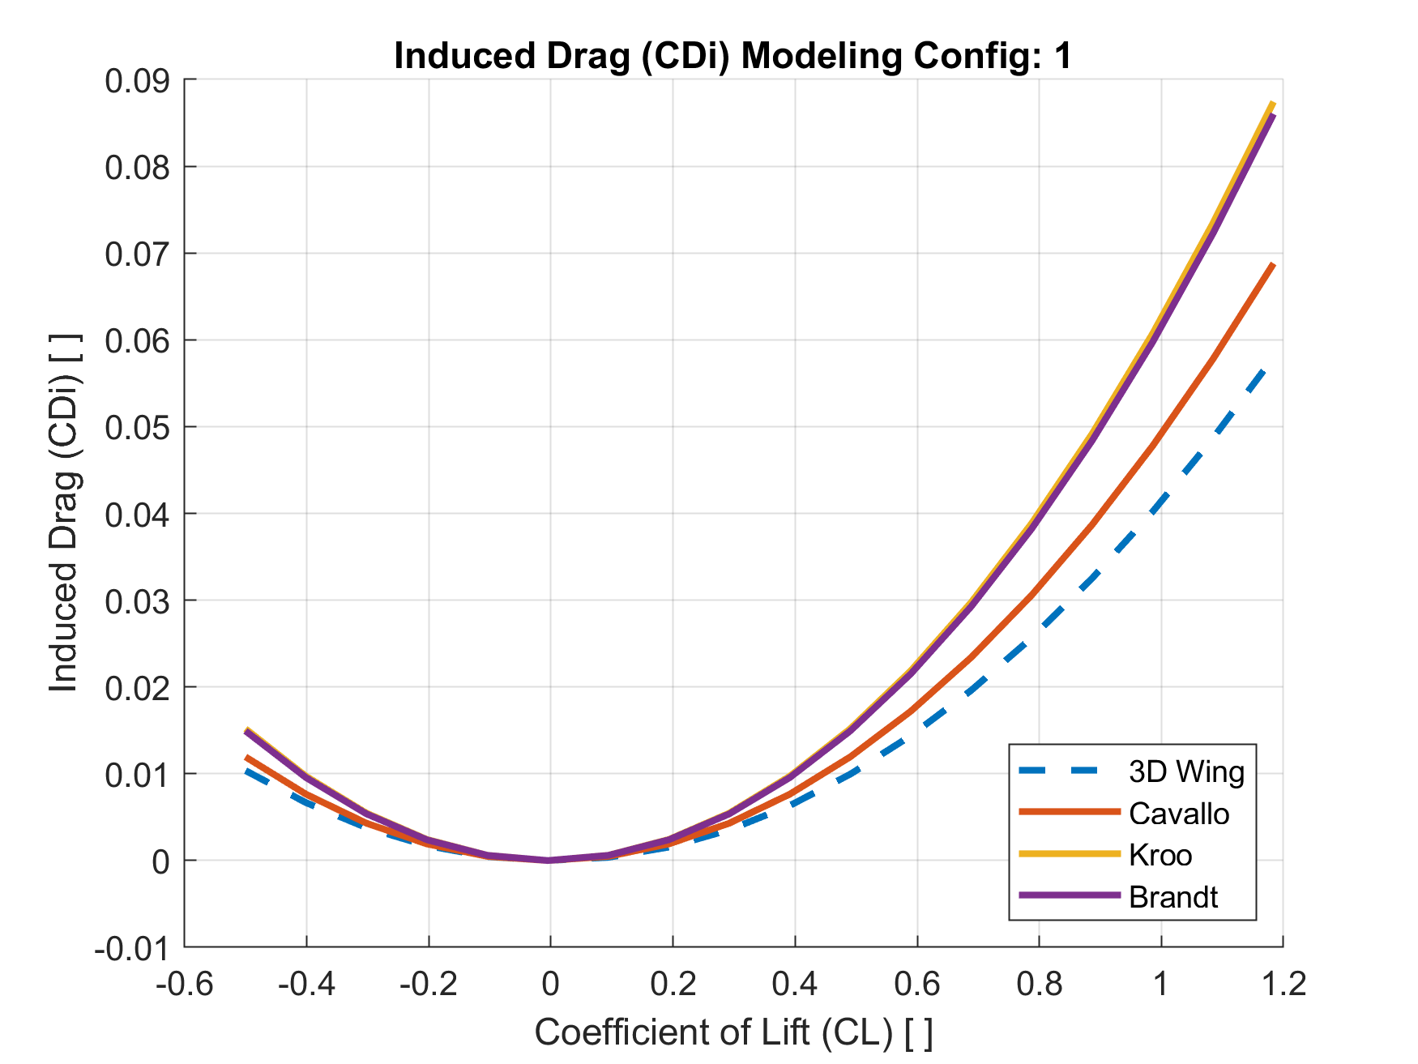
Induced Drag Models
Insert your Induced Drag Plot (CDi vs CL) here:
Include on the same plot
  Induced Drag 3-D Wing-Only
  Induced Drag Model using Cavallo Oswalds Model
  Induced Drag Model using Nita-Scholz Oswalds Model
  Induced Drag Model using Student Choice Oswalds Model
Make sure plot is formatted adequately
  Axis Titles + Units (if applicable)
  Proper range used for both vertical and horizontal axes
  Legend
Oswalds Model | Oswalds Efficiency Factor (e_{o}) | K1 Value
Cavallo | 0.8079 | 0.0487
Kroo | 0.6357 | 0.0619
Brandt | 0.6461 | 0.0609

Slide 5
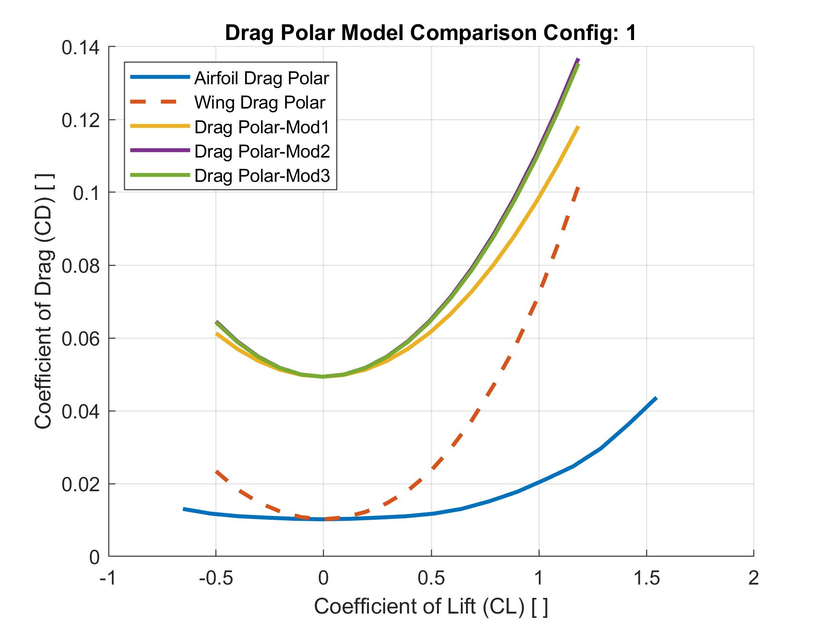
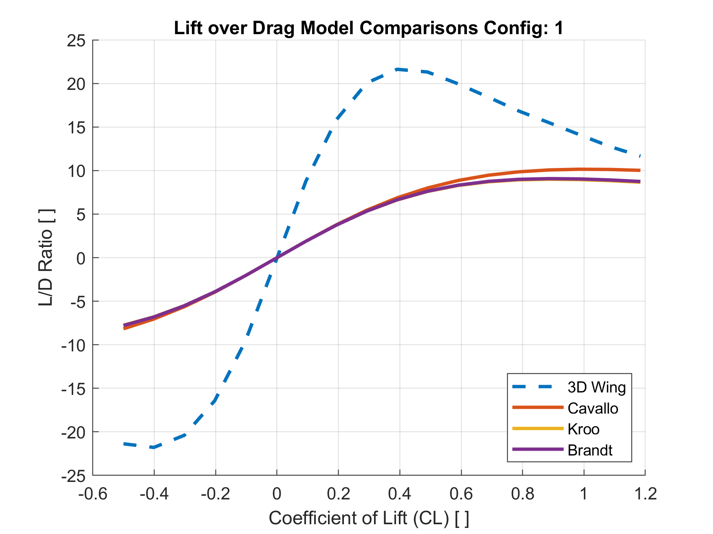
Drag Polar Benchmark Comparison Plots
Insert your Complete Drag Polar Plot (C_{D} vs C_{L}) here:
Include on the same plot
  Drag Polar 3-D Wing-Only
  Drag Polar Model using Cavallo Oswalds Model
  Drag Polar Model using Student Choice Oswalds Model 1
  Drag Polar Model using Student Choice Oswalds Model 2
Make sure plot is formatted adequately
  Axis Titles + Units (if applicable)
  Proper range used for both vertical and horizontal axes
  Legend
Insert your L/D Comparison Plot (L/D vs C_{L}) here:
Include on the same plot
  L/D variation for 3-D Wing-Only
  L/D variation for Cavallo Oswalds Model
  L/D variation for Student Choice Oswalds Model 1
  L/D variation for Student Choice Oswalds Model 2
Make sure plot is formatted adequately
  Axis Titles + Units (if applicable)
  Proper range used for both vertical and horizontal axes
  Legend

Slide 6
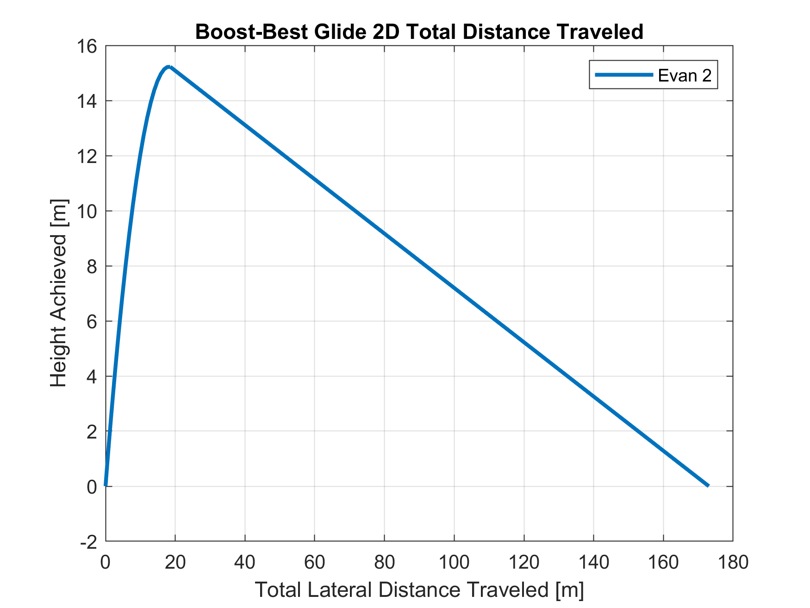
Flight Dynamics Model: Boost-Glide Performance
Insert your Boost-Best Glide 2D Total Distance Traveled Plot here:
You should only have one flight profile line using your choice for the aero drag polar model (Defined through L/D data inputted into your Glide Flight Dynamics call statement in MATLAB)
Make sure plot is formatted adequately
  Axis Titles + Units (if applicable)
  Proper range used for both vertical and horizontal axes
  Legend
Propulsion Design Choices
Bottle Volume Selected | 2.0 Liter
Water Volume Selected | 600 mL
Performance Metric | Estimated Performance
Boost Max Apogee | 15.22 m
L/D max | 10.15
C_{L} at L/D max | 0.3912
Angle of Attack at C_{L} for L/D max (deg) | 4 deg
Velocity @ L/D max (m/s) | 10.5 m/s
Sink Rate Velocity @ L/D max (m/s) | 1.03 m/s
Max Glide Range (m) | 154.4 m

Slide 7
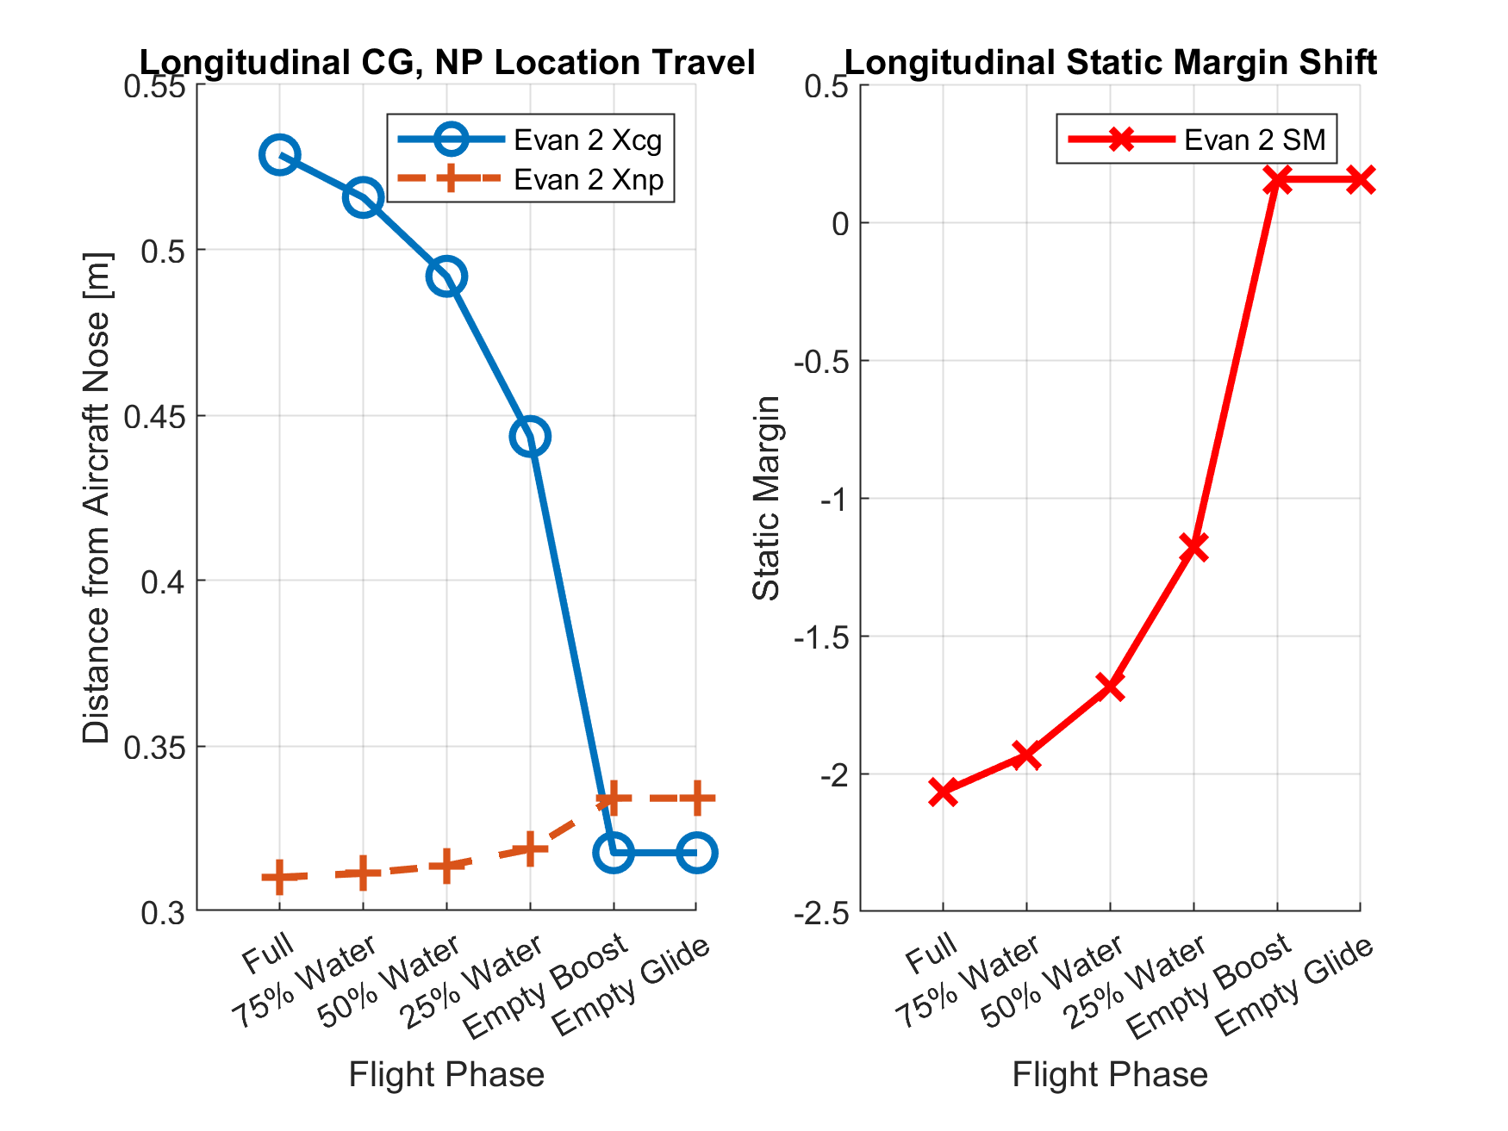
Flight Dynamics Model: Longitudinal Static Stability

